Slide 1
Group 13
"Review score analysis based on delivery duration"
Praful Patil- PVP220001
Sanjana Belde- SXB220133
Srejanya Reddy- SXO220000
Tulasi Smrithi-TXY220003

Slide 2
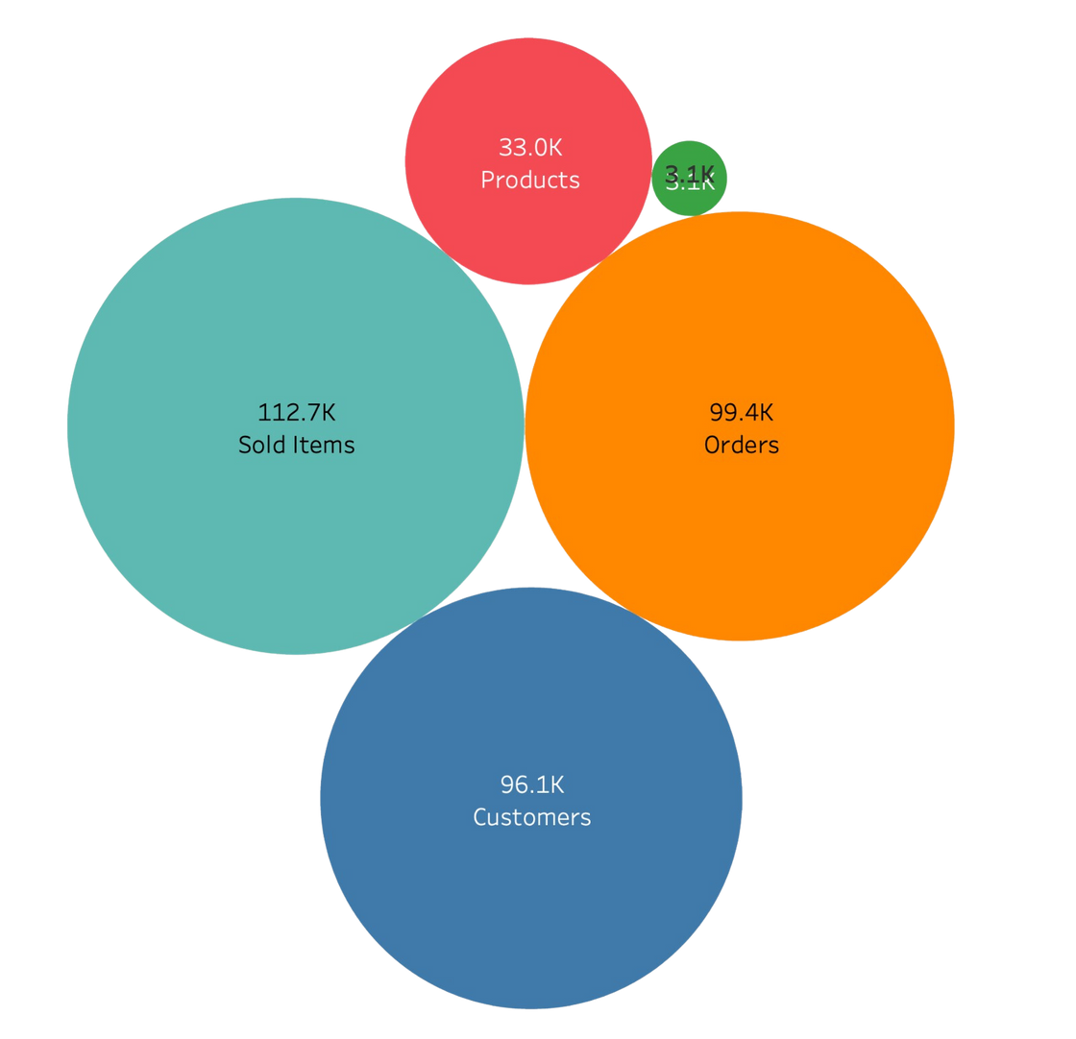
INTRODUCTION:
Dataset:
Brazilian E-Commerce Public Dataset by Olist
Dataset Source:
Kaggle
The Data:
Contains comprehensive data on 100k orders spanning from 2016 to 2018, originating from various marketplaces in Brazil.

Slide 3
INDUSTRY CONTEXT
Olist:
The leading department store in Brazilian marketplaces, serving as a crucial link for small businesses across Brazil.
Olist simplifies market access for merchants through a single contract, enabling them to sell products via the Olist Store and utilize Olist's logistics partners for efficient customer shipments.
Following a purchase, customers receive satisfaction surveys via email to provide their feedback on the overall shopping experience.

Slide 4
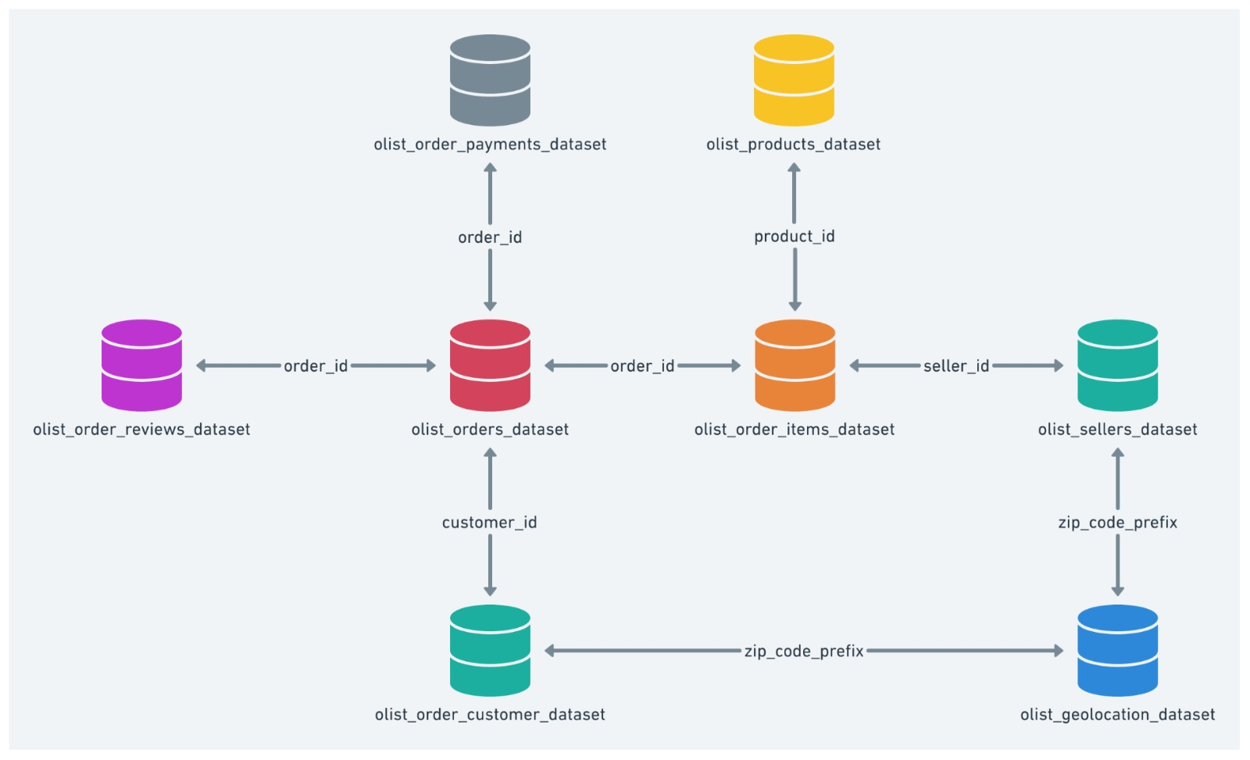
After consolidating all the tables, the dataset comprises over 40 distinct features.

Slide 5



Objective
Conduct spatial analysis to substantiate the beta values.
Review Score Analysis
Conduct spatial analysis to substantiate the beta values.
Uncover insights into the factors influencing review scores, ultimately contributing to enhanced customer satisfaction and business performance.

Slide 6
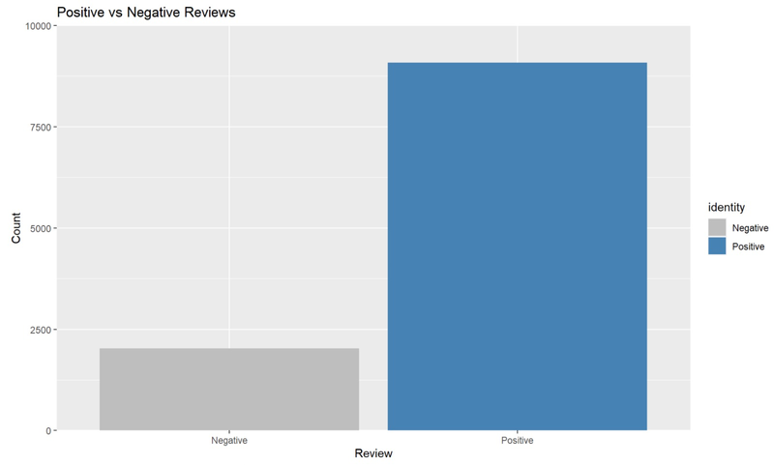
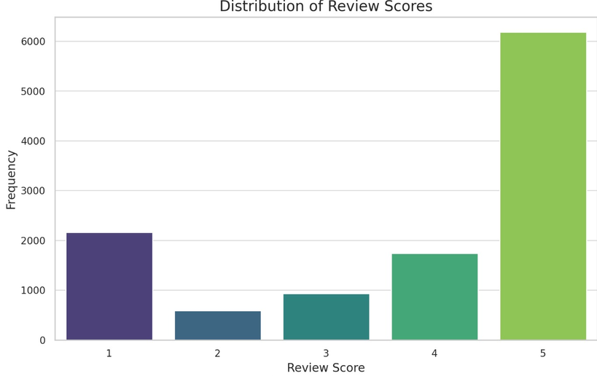
MODEL SELECTION
LINEAR REGRESSION VS LOGISTIC REGRESSION
Data Nuance Preservation: Linear regression retains intricate review score details, avoiding oversimplification compared to logistic regression.
Ordinal Data Handling: Linear regression effectively manages discrete ordinal review scores (1 to 5), capturing subtle differences for nuanced analysis.
Economic Insights: Linear regression clarifies economic implications of predictor variables, aiding informed business decisions by revealing each factor's contribution to overall review scores.

Slide 7
MODEL RESULTS INTERPRETATION
Out of the 10 features that exhibited correlations with review scores for eg. product photos quantity or length of product description, only 2 were found to be statistically significant.
 | Estimate | p value | Economic Significance
(Intercept) | 4.2224478 | < 2e-16 *** | Baseline expected review score when all other variables are zero.
freight value | -0.002671 | 0.000781 *** | Slight decrease in review score with each dollar increase in freight value.
delivery duration | -0.047465 | < 2e-16 *** | Negative relationship between delivery duration and review score; longer times lead to lower scores.
Understanding calculated feature: Delivery Estimated accuracy: Delivery Estimated Duration is calculated by measuring the time between the estimated delivery date and the actual delivery date. It is a crucial metric for assessing logistics efficiency, as it helps identify the accuracy of our delivery predictions and areas where improvements can be made. | Understanding calculated feature: Delivery Estimated accuracy: Delivery Estimated Duration is calculated by measuring the time between the estimated delivery date and the actual delivery date. It is a crucial metric for assessing logistics efficiency, as it helps identify the accuracy of our delivery predictions and areas where improvements can be made. | Understanding calculated feature: Delivery Estimated accuracy: Delivery Estimated Duration is calculated by measuring the time between the estimated delivery date and the actual delivery date. It is a crucial metric for assessing logistics efficiency, as it helps identify the accuracy of our delivery predictions and areas where improvements can be made. | Understanding calculated feature: Delivery Estimated accuracy: Delivery Estimated Duration is calculated by measuring the time between the estimated delivery date and the actual delivery date. It is a crucial metric for assessing logistics efficiency, as it helps identify the accuracy of our delivery predictions and areas where improvements can be made.
delivery estimated accuracy | 0.0014291 | 0.355295 | More accurate delivery estimates show a non-significant slight positive effect on review scores.

Slide 8
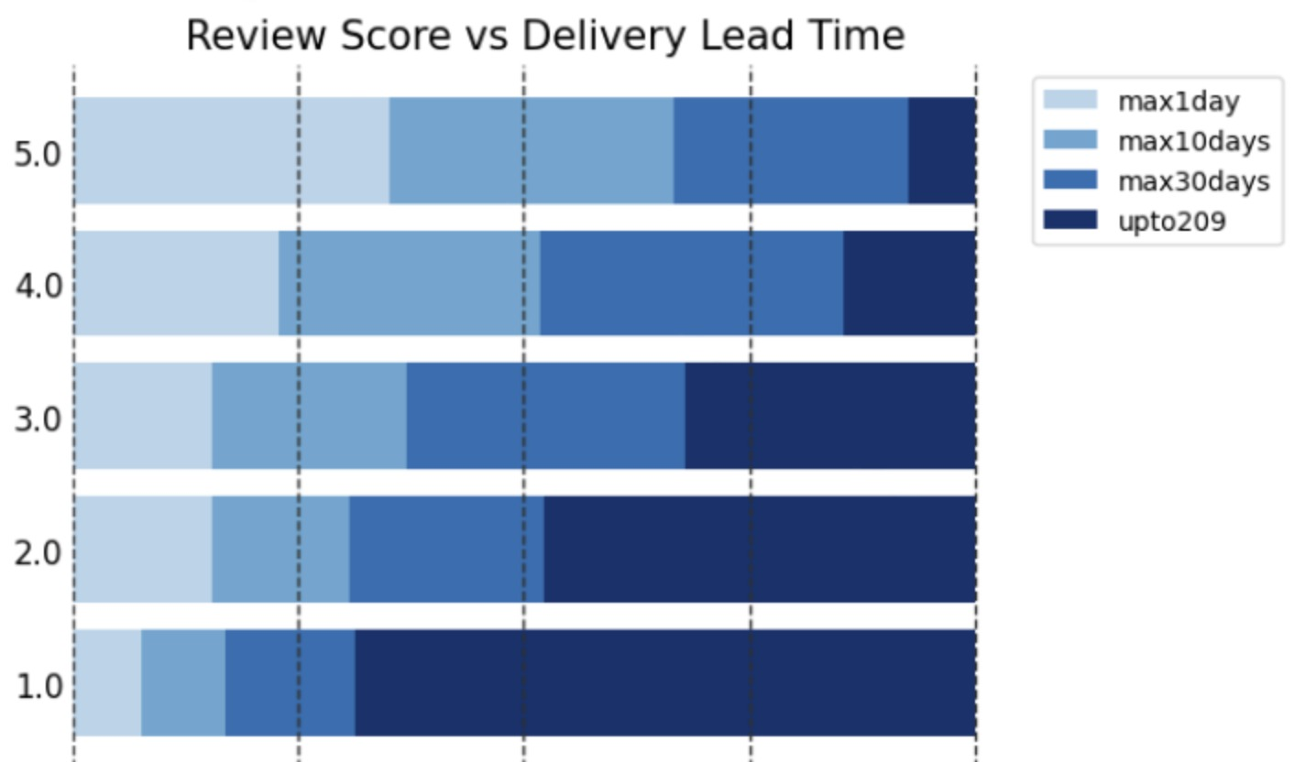
Distribution of Delivery lead time against review score
This image shows how different review scores are associated with delivery times. For example, if we consider 5.0, people who got deliveries within 10 days make up more than 50% of the data. On the other hand, if we consider 1, people who got their deliveries very late make up more than 50% of the data.

Slide 9
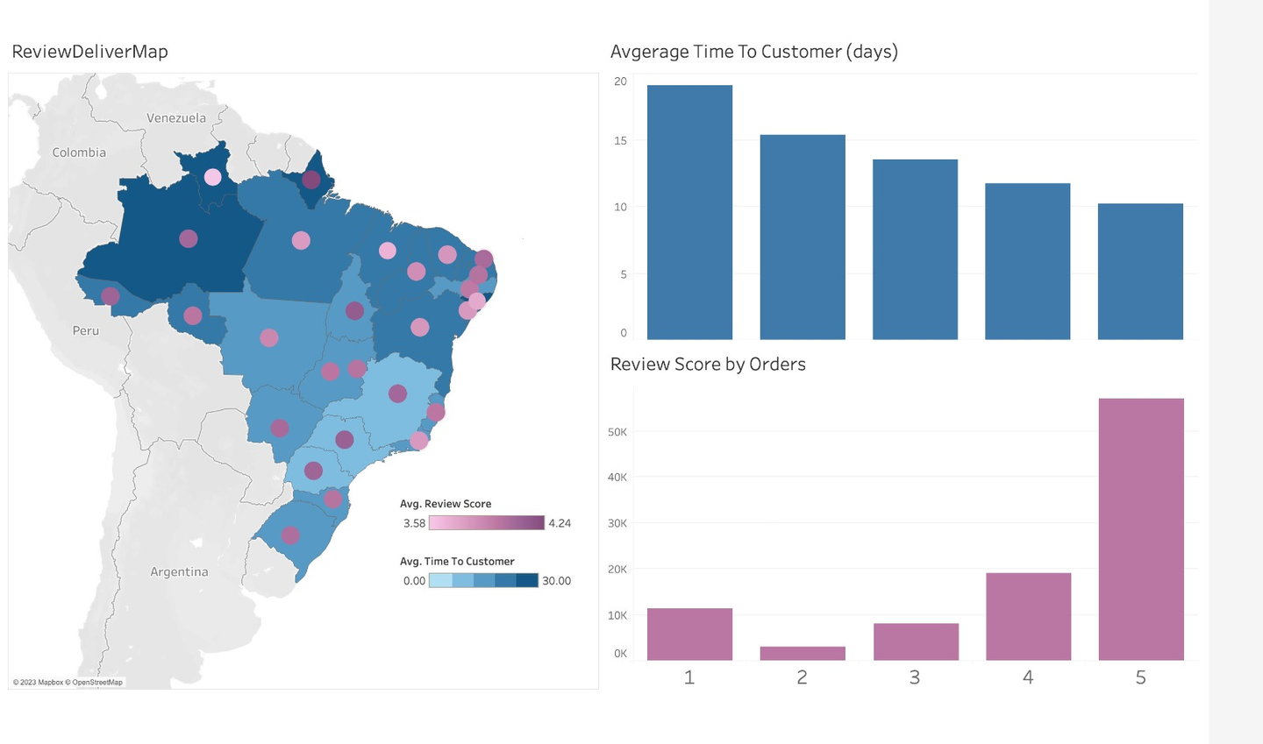
Spatial analysis of review score
Reduced Delivery Time Associated with Higher Review Scores
Northern regions have longer duration to reach the customers when compared to south-east regions

Slide 10
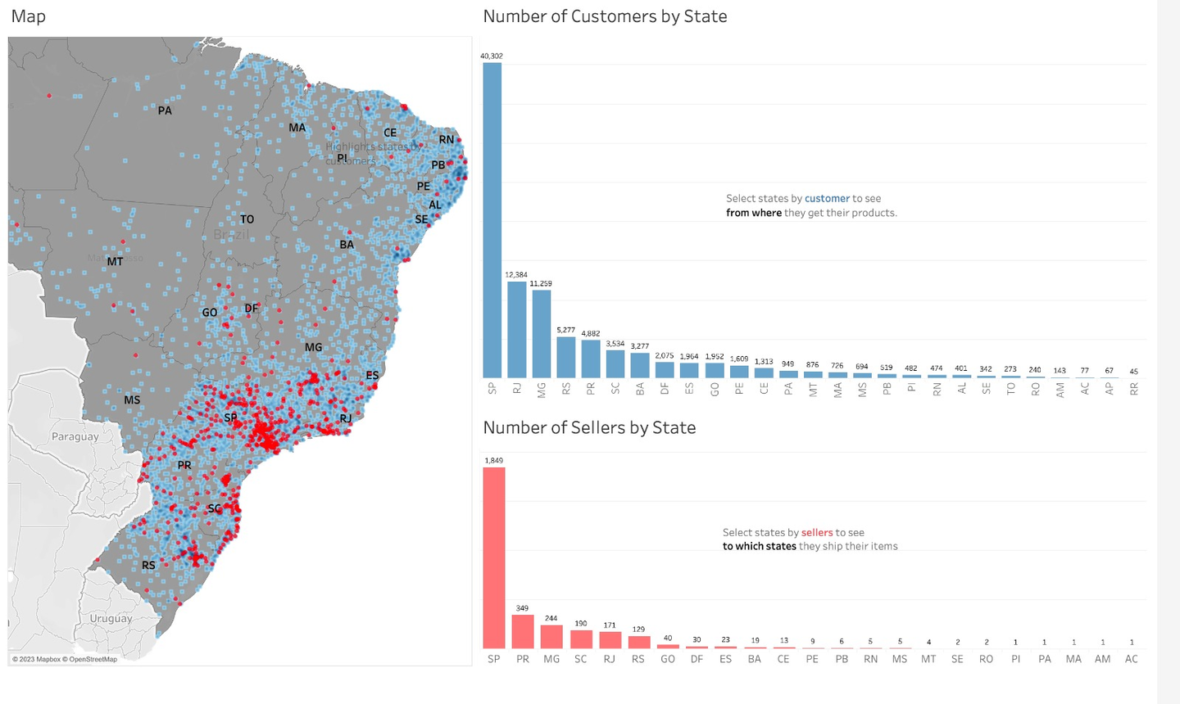
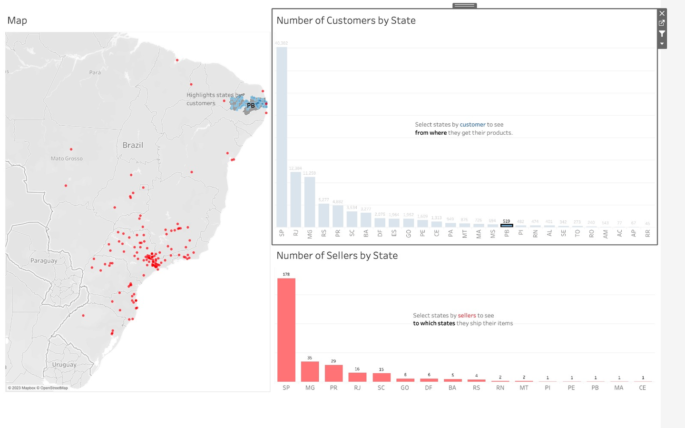
Geographical Distribution of Sellers
Sellers are concentrated in the South-east Regions.
people from PB state are ordering items from the highlighted sellers which will impact on the customer review score since it will take longer time to deliver the products

Slide 11
Result
Each 1-day delay in delivery is linked to a 0.047-point decrease in review score.
Conclusion
1. Customer Communication:
Set clear expectations regarding delivery times during the ordering process.
Proactively communicate delays and offer transparent tracking information.
2. Warehouse Placement:
Strategically position warehouses to reduce shipping distances.
Consider regional demand to enhance proximity to key customer bases.

Slide 12
Thank You

